Slide 1
Introduction to Deep Learning
21/08/2023 – 24/08/2023
Online

Slide 2
Agenda
Days | Chapter
Day 1 | Introduction to Deep Learning
Day 1 & Day 2 | Classification by a Neural Network
Day 2 & Day 3 | Monitor the Training Process
Day 4 | Advanced Layer Types

Slide 3
Agenda – Day 1
Time | Topic
9:00 | Welcome and icebreaker
9:15 | Introduction to Deep Learning
10:15 | Coffee break
10:30 | Classification by a Neural Network
11:30 | Coffee break
11:45 | Classification by a Neural Network
12:45 | Wrap-up
13:00 | END

Slide 4
Collaborative Document
www.tinyurl.com/2023-08-21-ddi-day1
Please fill in the Roll Call
Please read through the code of conduct for the workshop
Notes:
Code of Conduct
Non-verbal feedback
Icebreaker
Command log

Slide 5
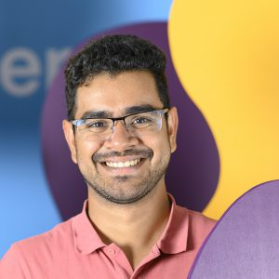
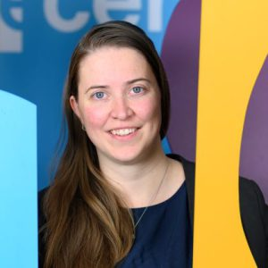
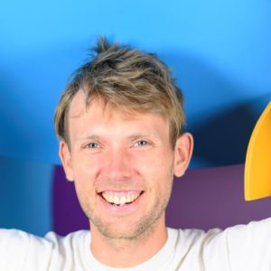
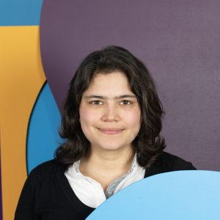
Instructors and Helpers
Pranav Chandramouli
Laura Ootes
Sven van der Burg
Luisa Orozco

Slide 6






The Netherlands eScience Center

Slide 7

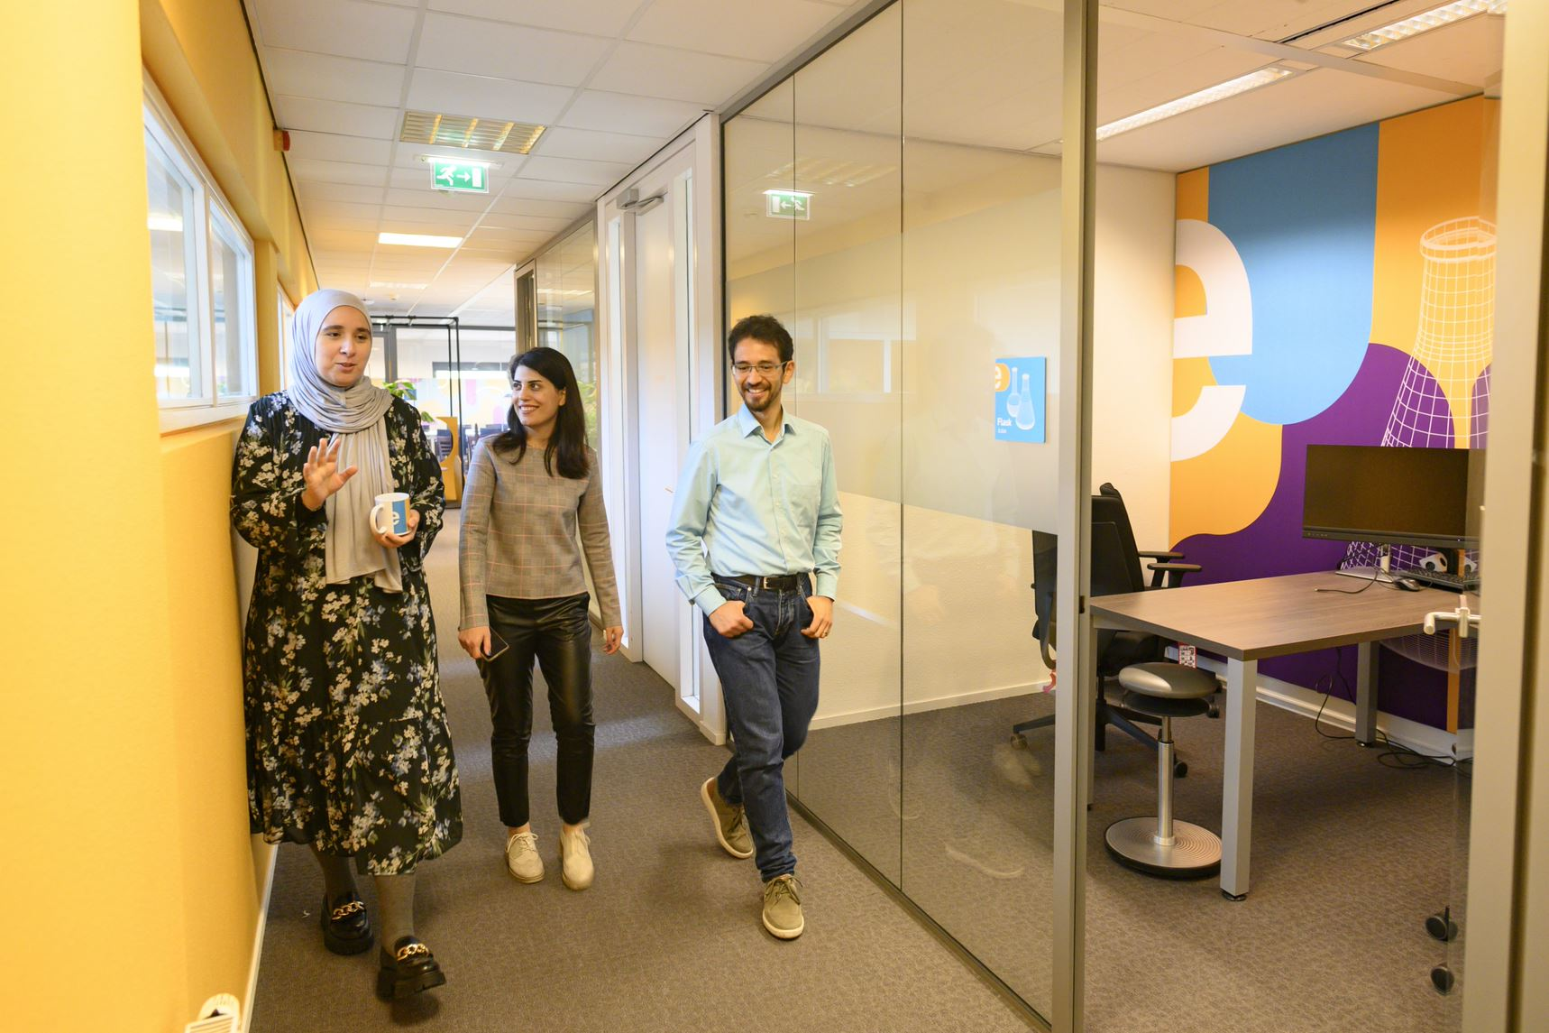

Who are we?
The Netherlands eScience Center is a national center for innovative software solutions in academic research.
Established to bridge the gap between digital technologies and scientific and scholarly inquiry.
Our Research Software Engineers
help researchers interpret results,
make tools and methods reusable for the wider research community,
co-author research and methodological publications.

Slide 8

Digital Skills Programme​​
Hands-on courses, 2-3 days
In person & online
Based on The Carpentries & CodeRefinery, and
In-house developed materials.
Topics cover:
Open & Reproducible Research Software
Intermediate and Advanced Research Software Skills
Advanced Technologies (e.g. GPUs, Deep Learning)
Schedule 2023
January | Data Analysis and Visualisation in Python for Researchers Machine learning in Python with scikit-learn | July | Parallel Programming with Python
March | Reproducible research with R packages Intermediate Research Software Development with Python Astronomical Data Science with Python | August | Introduction to Deep Learning
April | Parallel Programming with Python GPU programming | September | Reproducible research with R packages
May | Introduction to Geospatial Raster and Vector Data with Python Introduction to Deep Learning | October | Good Practices in Research Software Development (CodeRefinery Introduction to Geospatial Raster and Vector Data with Python
June | Image Processing with Python Good Practices in Research Software Development (CodeRefinery) | November | GPU programming Machine learning in python with scikit-learn Intermediate Research Software Development with Python

Slide 9
See upcoming workshops: esciencecenter.nl/events/?f=workshopsnl/events/?
To be notified about coming up workshops, subscribe to the Newsletter: eepurl.com/dtjzwP

Slide 10
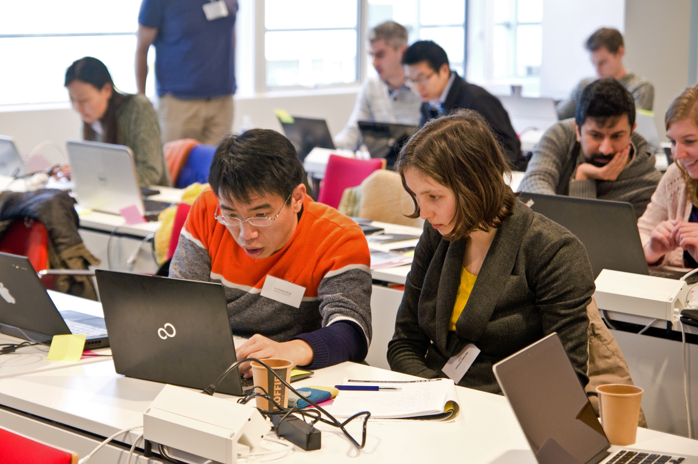


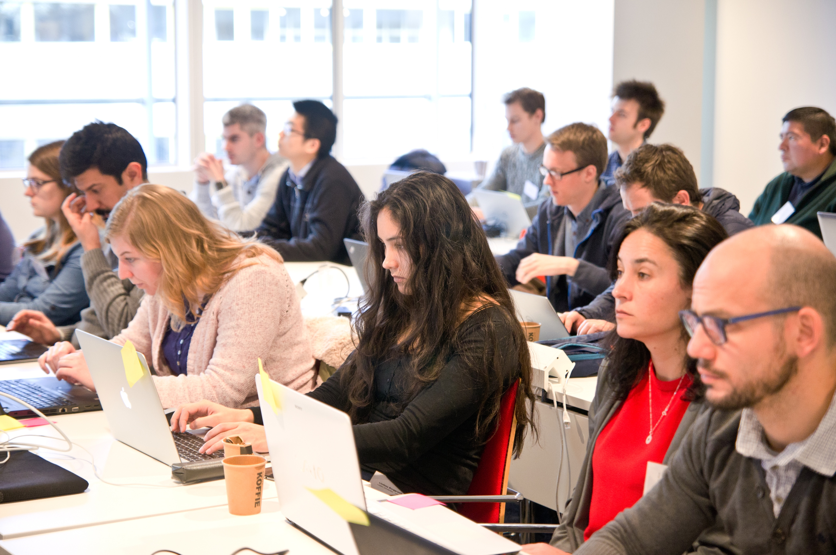

Our Digital Skills Workshops are free and open to researchers in the Netherlands. We also offer paid options of custom workshops dedicated to your organisation. To learn more, contact: training@esciencecenter.nl
Do you want us to come and teach a custom workshop at your organisation?

Slide 11
Do you want to teach with our materials?
All material that we use is open-source available
We can help you setup workshops, contact training@esciencecenter.nl

Slide 12

NL-RSE brings together the community of people writing and contributing to research software from Dutch universities, knowledge institutes, companies and other organizations to share knowledge, to organize meetings, and raise awareness for the scientific recognition of research software.
Website: https://nl-rse.org/
Email: info@nl-rse.org
Twitter: @nl_rse

Slide 13








Let’s stay in touch
www.eScienceCenter.nl
info@esciencecenter.nl
+31 (0)20 460 4770
@eScienceCenter
Netherlands Escience Center
@eScienceCenter@akademienl.social

